Slide 1
Home Credit Default Risk
Will more features help?
Leung, Ko Tsun
Cheng, Tsz Yui
Yang, Po-Yen

Slide 2

About
Overview
Agenda
Home Credit Default Risk
01 Introduction & Problem Statement
02 Data & Data Preprocessing
03 EDA & Feature Selection
04 Introduction & Problem Statement
05 Models
06 Result & Analysis
07 Conclusion

Slide 3
INTRODUCTION

Slide 4
Introduction
Home Credit is trying to provide loans to people lack of credit history by predicting his/her ability to pay back with respect to his/her other alternative or historical data.
In this project, we utilized logistic regression and light Gradient Boosting Machine (light GBM) as our prediction models.

Slide 5
Problem Statement
Observation
A subset of features can obtain similar accuracy with a lower computation cost compared to using the full dataset
Amount of features
Motivated by this, we want to study the effect of including more features in our model
We have merged four datasets with over 600 features (6x more than the original dataset) and examined the improvement of utilizing more features during prediction

Slide 6
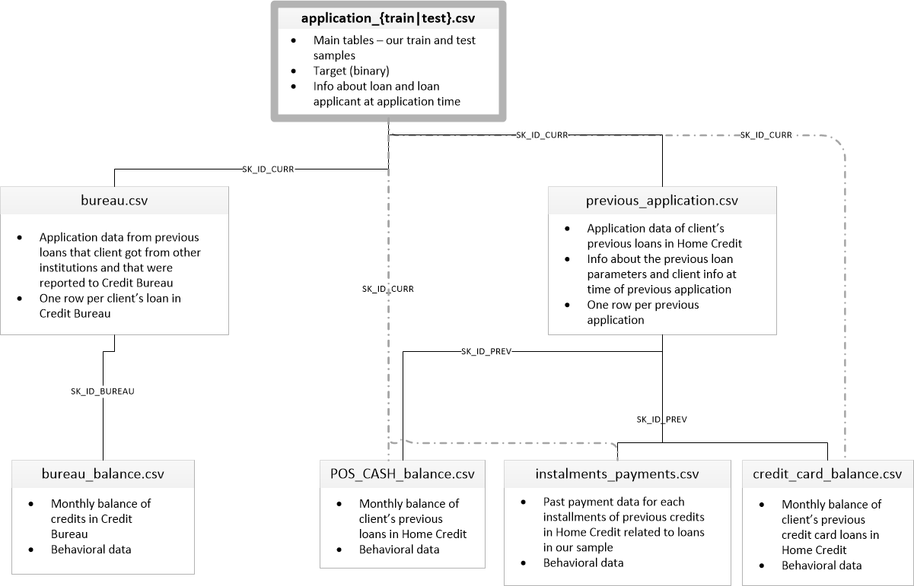
Data Overview
Full dataset consists of seven tables
In our model, we used the following tables:
application_train
bureau
bureau_balance
previous_application
bureau and balance data are aggregated in the training dataset
Test dataset merged

Slide 7
Data & Data Preprocessing
Various types of variables are present
Numerical
Categorical
Binary
Data preprocessing method
Label encoding is used for features having <=2 unique values
One hot encoding is used for other features
Label encoding has the problem of arbirary ordering significance

Slide 8
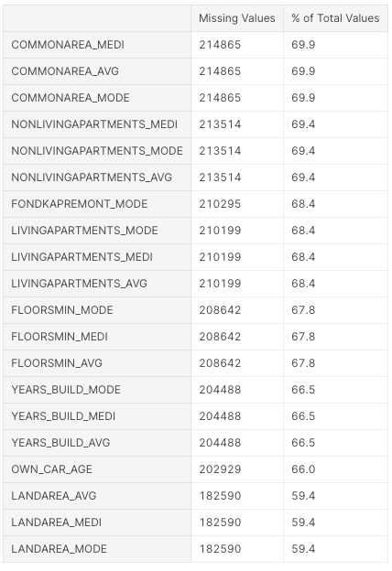
Data & Data Preprocessing
Missing value handling
Lots of predictor variables contain missing data
Drop features with high rate of missing values (70%)
Fill in the missing values by median
Advantage : Median is not affected by outliers
Apply MinMaxScalar
Advantage : Compress all inliers in range [0,1]

Slide 9
Exploratory Data Analysis
Response variable
Occupation
Type of the Suite

Slide 10
Exploratory Data Analysis
An open-ended process where we calculate statistics and make figures to find trends, anomalies, patterns, or relationships within the data
Objectives:
To learn what the data can tell us
Make decision on our model choices by helping us determine which features to use

Slide 11
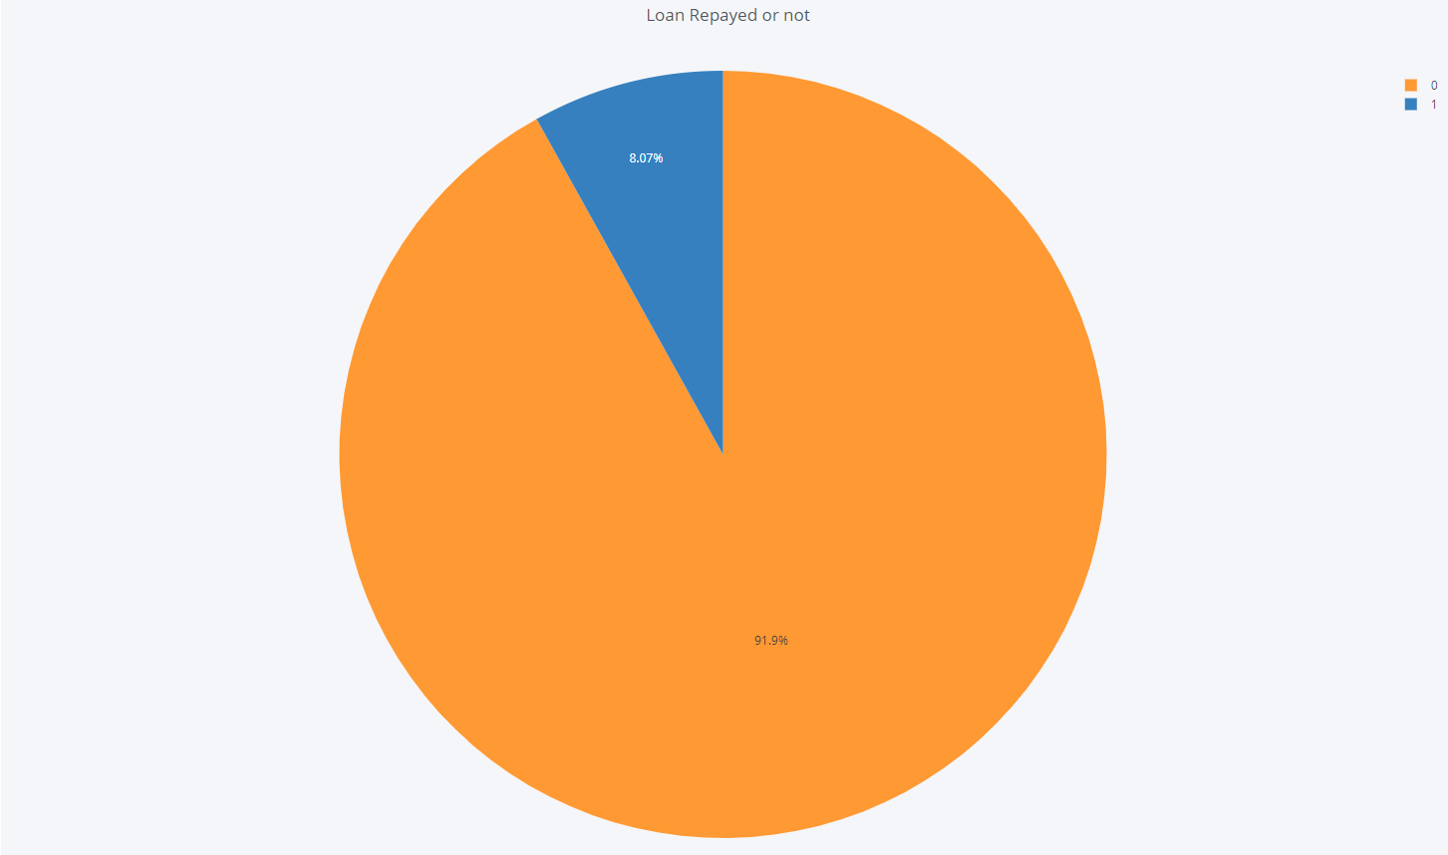
EDA -
Response Variable
Characterisics
0 for loan repaid on time
1 for clients having payment difficulties
Highly imbalanced: Much more 0s than 1s
Weighting is preferred

Slide 12
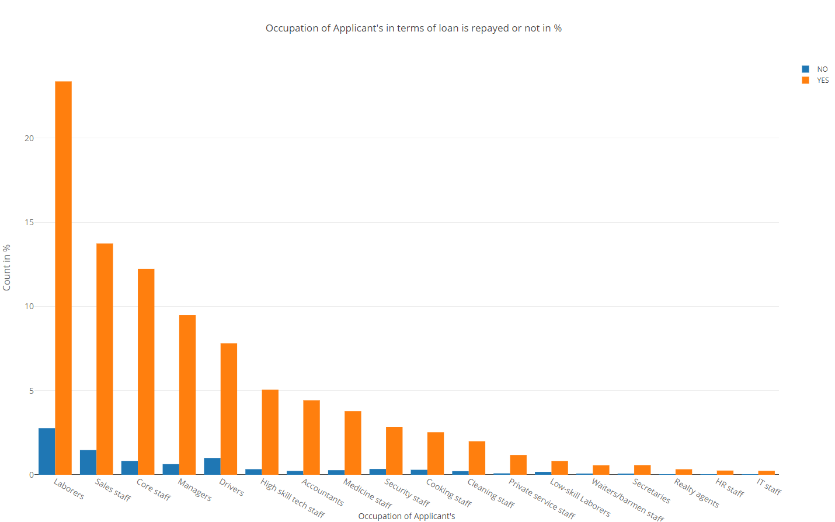
EDA
Occupation of Applicants
Applicants of most occupation are able to repay loan on time.
Among all, laborers, sales staff and drivers contain the highest proportion of applicants who are unable to repay loan on time

Slide 13
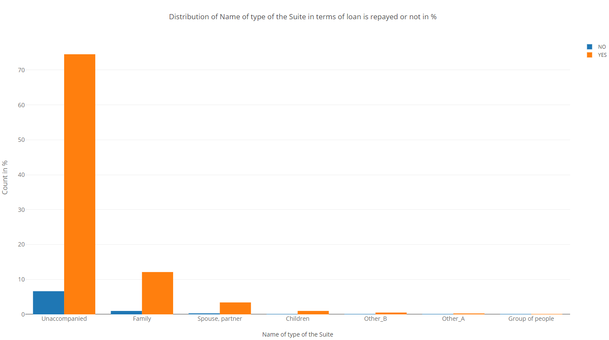
EDA
Type of the Suite
Applicants who are unaccompanied, have the highest chance of default
Those who live with family, spouse or children are more likely to repay loan. This could be explained by support from family members

Slide 14
Feature Selection
Filter features by the rate of missing values
Features with < 70% missing value are selected
Select features with high correlations against the target variable
Remove highly inter-correlated features
avoid multicollinearity
keep the features containing most info
Notes:
Filter features by the rate of missing values
Select features with missing value rate < 70%
Select features with sufficient correlations vs. target
Remove highly inter-correlated features to avoid multicollinearity
Keep the features with the highest information

Slide 15
Models
Logistic Regression
Light Gradient Boosting Machine (LightGBM)
Model Techniques

Slide 16
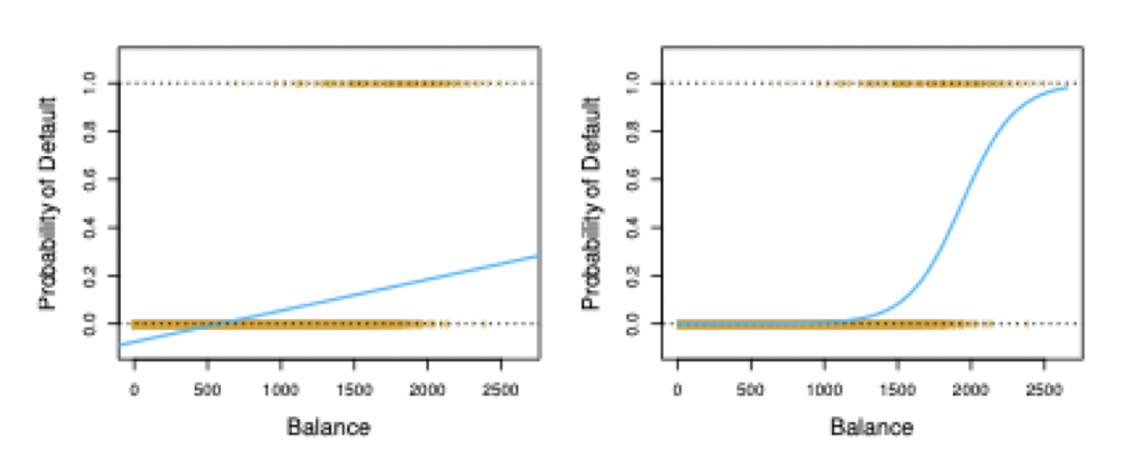
LOGISTIC REGRESSION
Useful for classifying categorical response values
Non-linear transformation to estimate probabilities between 0 and 1
Maximum likelihood estimation used to find parameters in model
Model assumptions
No outliers in the data
No multi-collinearity between the predictors
Linearity between dependent variable(Y) and the indepdent variables(X)
Advantage of this model
Easy to implement, interpret and efficient to train
Less-inclined to over-fitting
Disadvantage of this model
Low model complexity to obtain complex relations
Lower accuracy for high-dimensional dataset

Slide 17
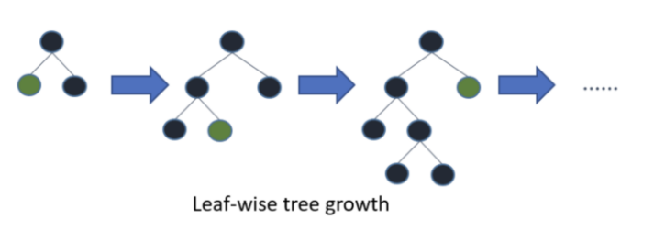
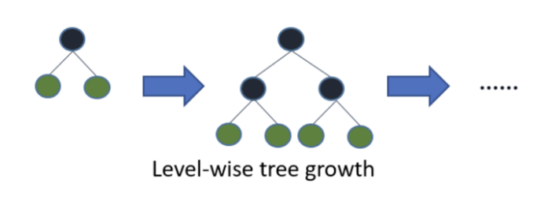
2. LIGHT GRADIENT BOOSTING MACHINE (Light GBM)
Revolutionary gradient boosting decision tree(GBDT) method
Developed by Microsoft in 2017, the most popular framework in Kaggle
Fast, distributed, high-performance gradient boosting framework based on decision tree algorithm
GBDT: ensemble model to learn decision by fitting residual errors in each iteration
Source code(in C++): https://github.com/microsoft/LightGBM
An improved model compared to XGBoost in terms of hardware and algorithms
LGBM is Leaf-Wise Tree Growth, compared to Level-Wise Tree Growth in XGBoost
User can minimize overfitting by limiting tree depth or number of leaves

Slide 18
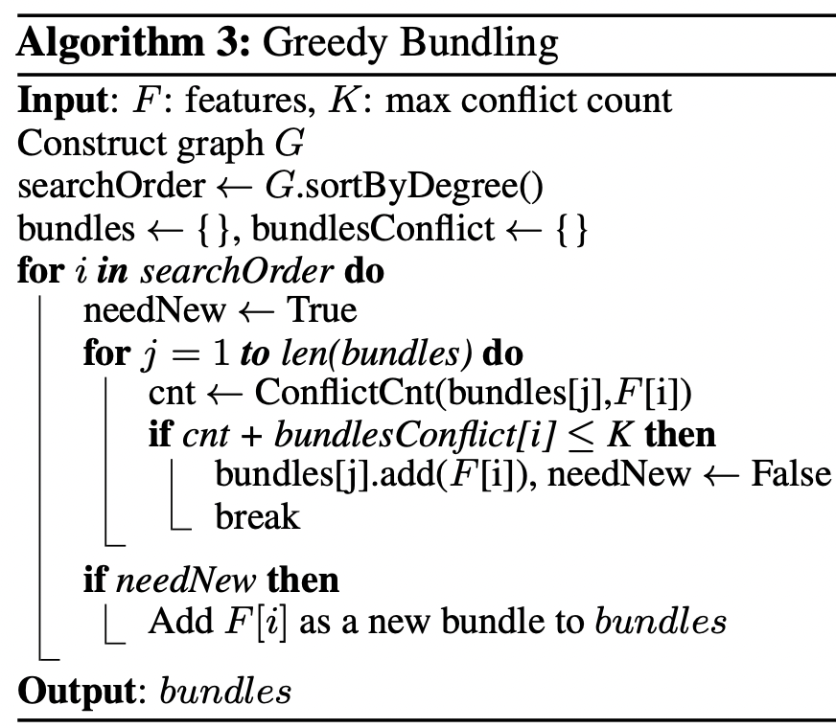
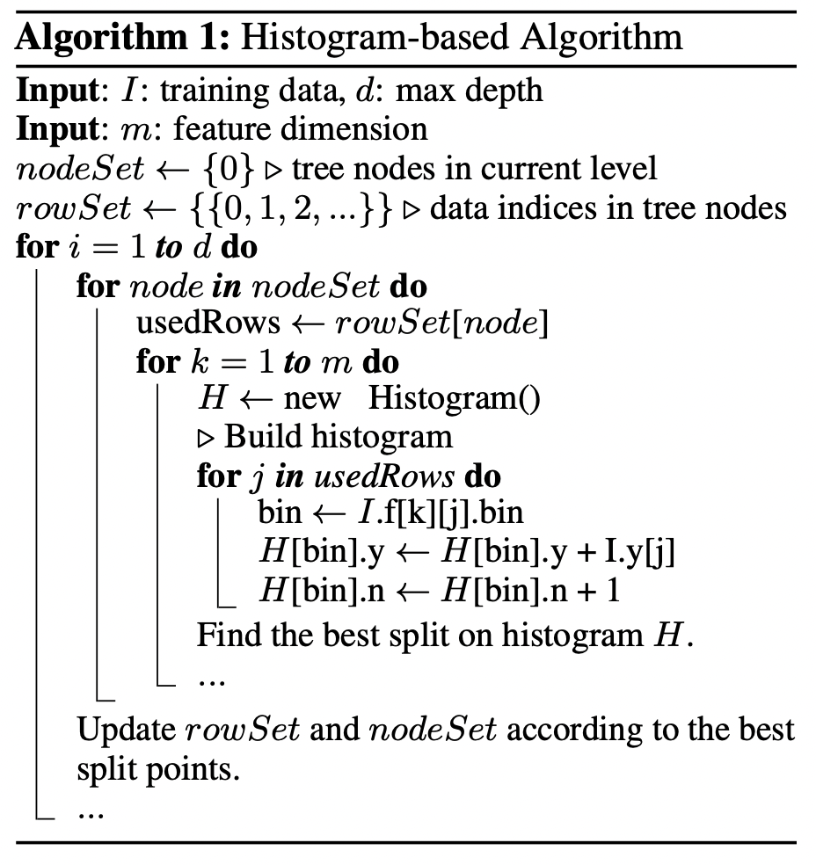
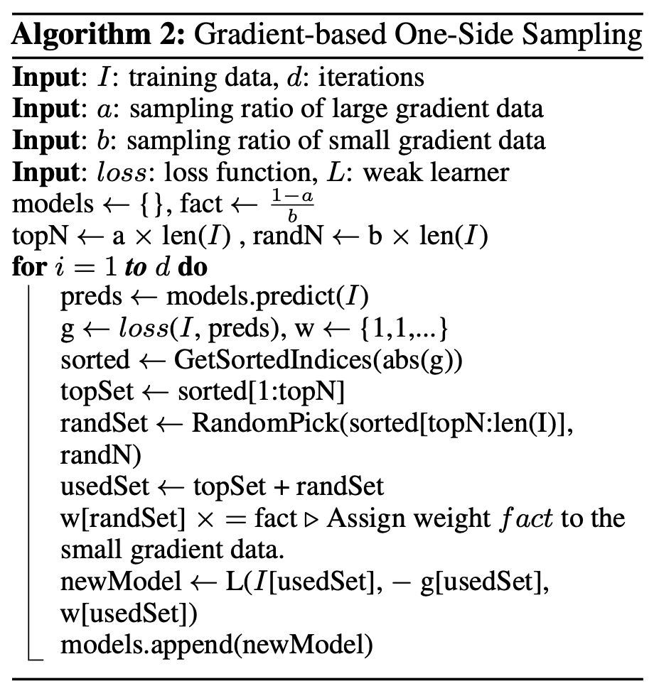
2. LIGHT GRADIENT BOOSTING MACHINE (Light GBM)
Gradient Based One Side Sampling (GOSS) & Exclusive Feature Bundling(EFB)
We want to select the Best Split with instances of larger gradients as they are undertrained
XGBoost uses a histogram-based algorithm with O(#bins * #feature) times, but still needs O(#data * #feature) to construct histogram
GOSS is a novel sampling method to retain large gradient instances, while keeping the data distribution by random sampling on small gradient instances
EFB is used to bundle mutually exclusive features to reduce the complexity to O(#data * #bundle) where #bundle << #feature
Takeaway: LightGBM adopts an effective way to split the decision tree based on gradient
Notes:
At a high level, the idea is that a data point with a small gradient is already minimized, so focus should be put onto those points with larger gradients.

Slide 19
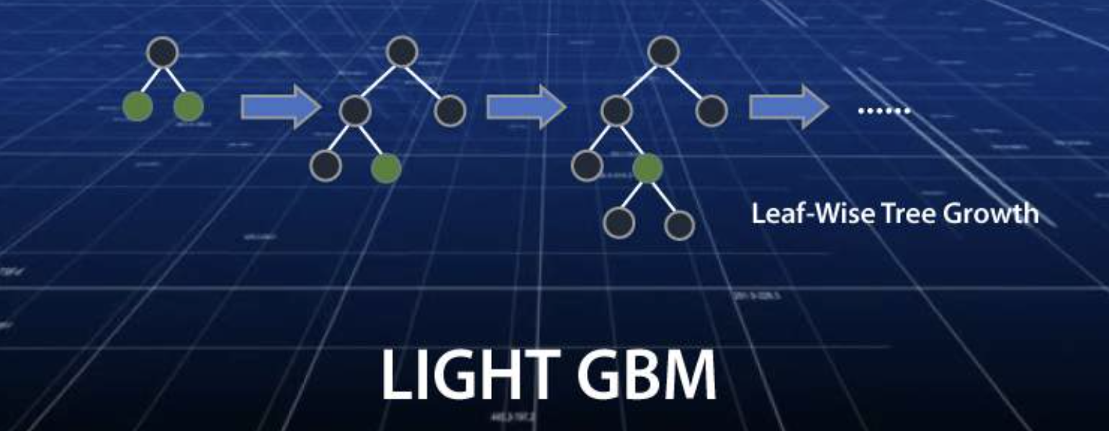
2. LIGHT GRADIENT BOOSTING MACHINE (Light GBM)
Advantages of LightGBM
Faster training speed and higher efficiency
Lower memory usage
Better accuracy than any other boosting algorithm
Parallel learning supported
Support categorical variables
Compatible with large datasets

Slide 20
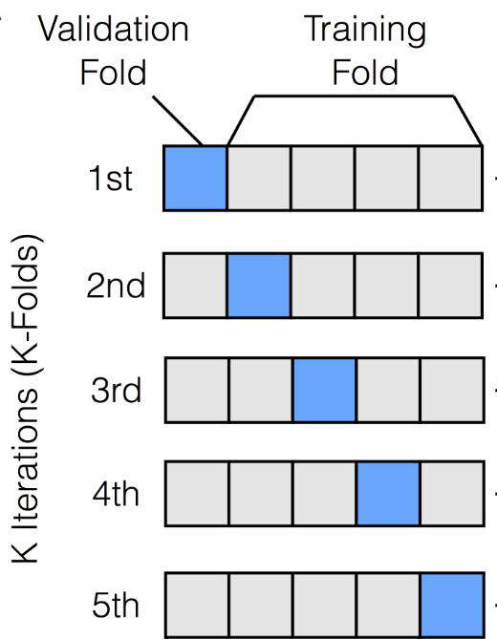
3. Model Techniques
Avoid overfitting
5-fold validation
LASSO/Ridge Regularization
Early Stopping
Fine tune and grid search for hyperparameters

Slide 21
RESULTS

Slide 22
Results
Logistic Regression (application only)
66.968%
Logistic Regression (merged dataset)
67.685%
Light GBM (application only)
71.793%
The following models and architectures are used as trials. The Light GBM with merged dataset is chosen as our model as it achieves the highest accuracy
Light GBM (merged dataset)
75.763%
Accuracy (Kaggle Score)
Model
METHOD 1

Slide 23
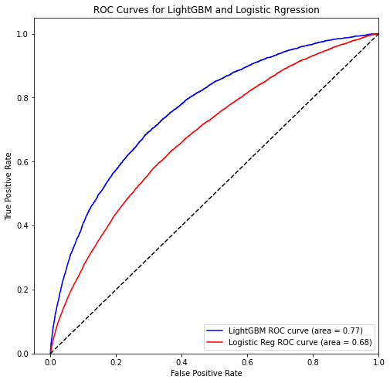
Results
Light GBM can achieve higher accuracy than logistic regression in merged dataset scenario

Slide 24
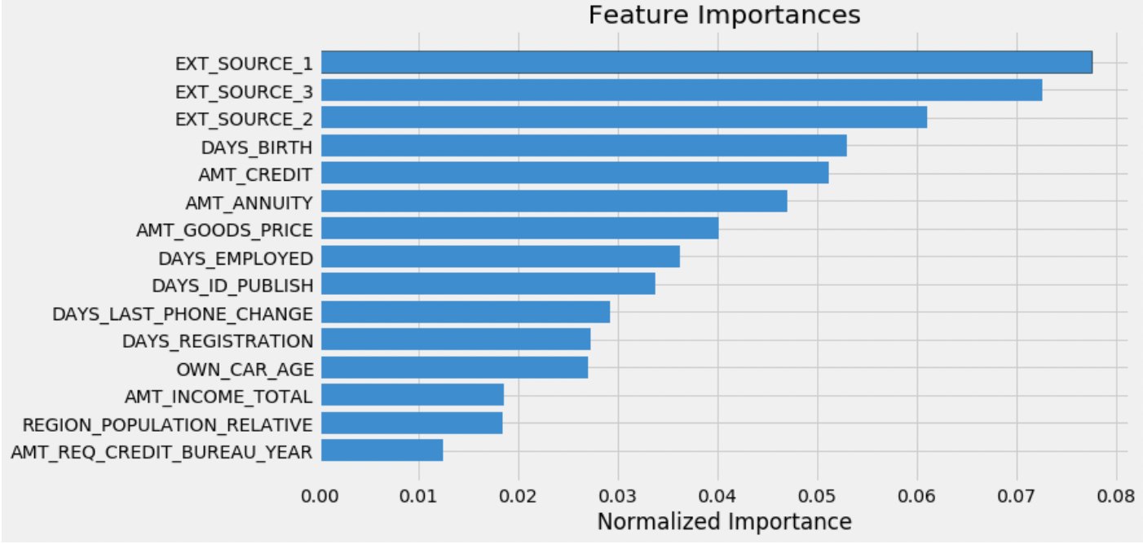
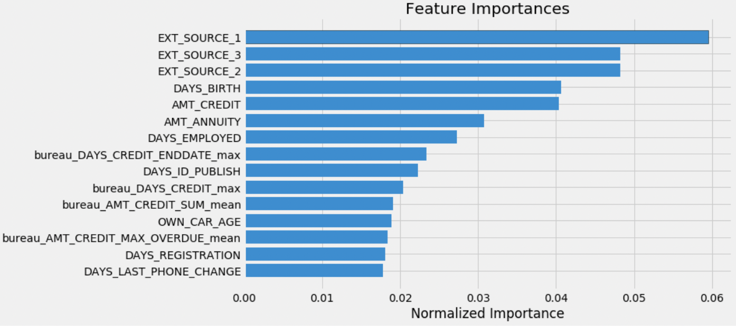
Results
EXT_SOURCE_1 & 2 & 3 are the most important features.
They are credit scores provided by external organizations.
DAYS_BIRTH is the age of the lender
AMT_CREDIT is credit amount of the loan
bureau_DAYS_CREDIT_ENDDATE is the remaining duration of outstanding credit at the time of application in Home Credit recorded by Credit Bureau
Feature importances for application_train only
Feature importances for merged datasets

Slide 25
CONCLUSION

Slide 26


‹#›
Conclusion
Number of features, Model selection
For both models, the prediction accuracy increases along with the number of features
Light GBM has better performance than logistic regression in terms of
Model complexity
Ability to extract important features

Slide 27

Thank You

